Slide 1
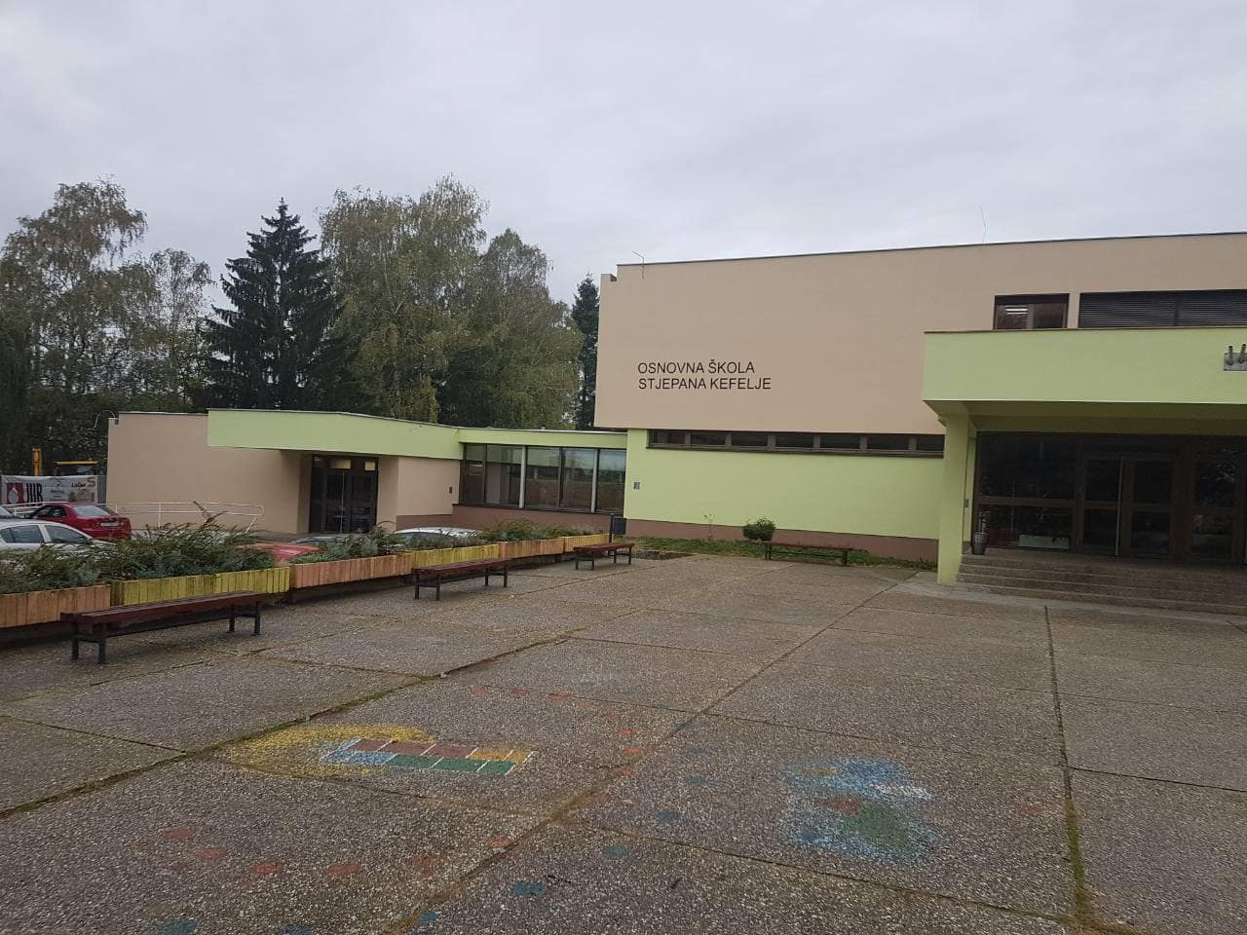
Stjepan Kefelja Primary School
Kutina, Croatia

Slide 2
General information
Address: Nikole Tesle 1, 44320 Kutina, Croatia
Tel: +385 44 660 850
E-mail: skola@os-stjepana-kefelje-kt.skole.hr
Number of pupils: 500 + 10 visiting pupils, asylum seekers from Syria
Number of school facilities : 3 (Kutina, Repušnica, Mikleuška)
Class teachers: 12, teaching pupils aged 6-10
Subject teachers: 30, teaching pupils aged 11-15
Pupil assistants (10), school pegagogue, psychologist, special educator
Headteacher: Ivica Petrović

Slide 3
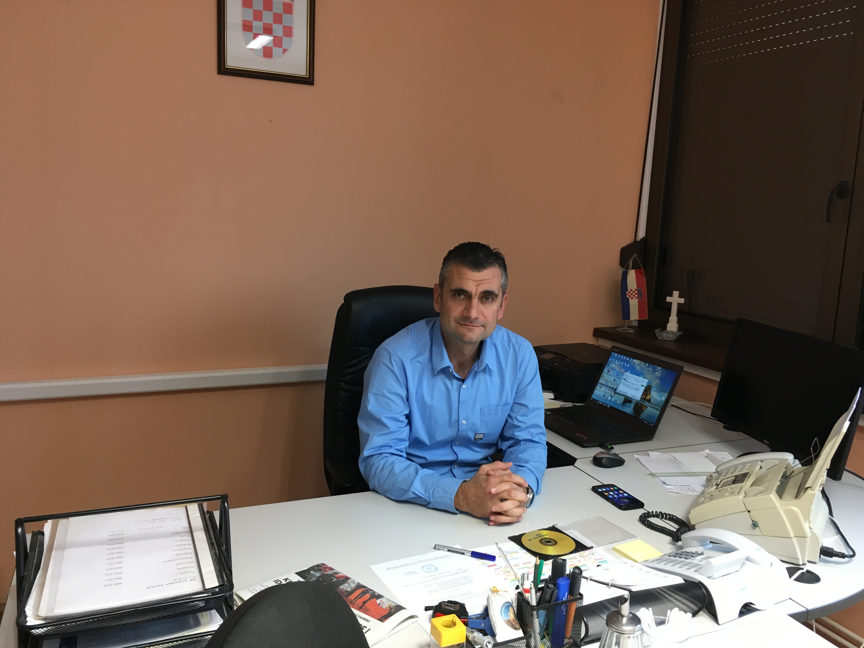
Our headteacher
Ivica Petrović- our former history teacher

Slide 4
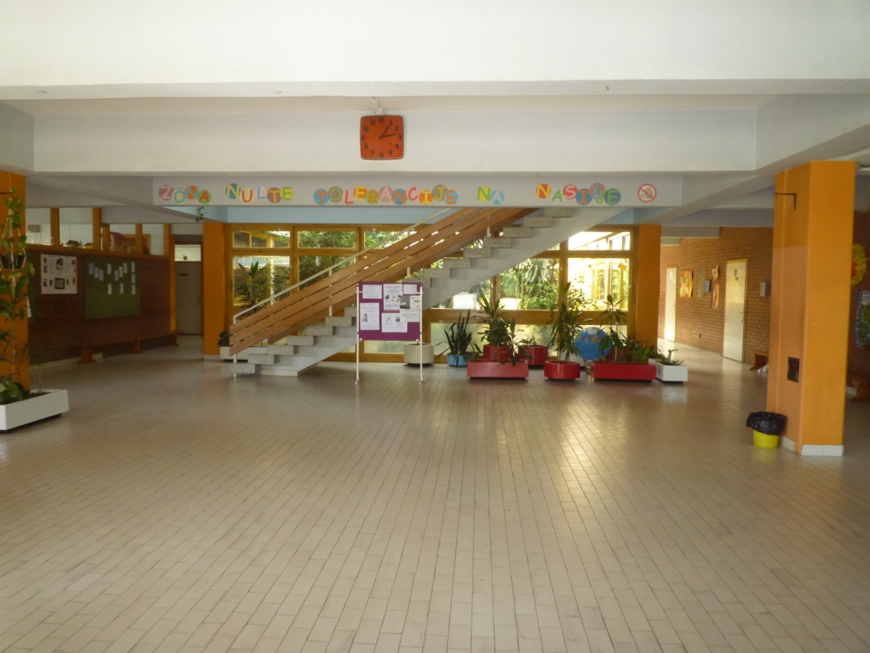
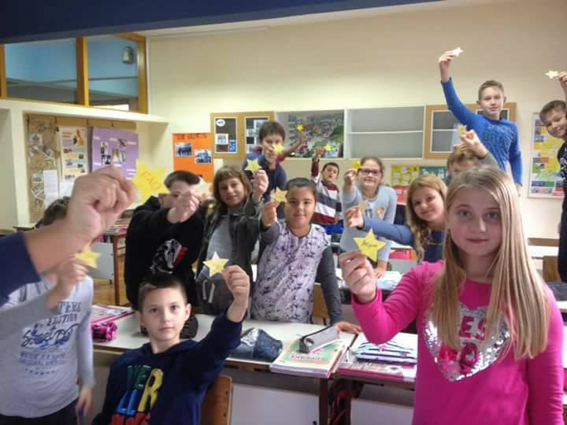
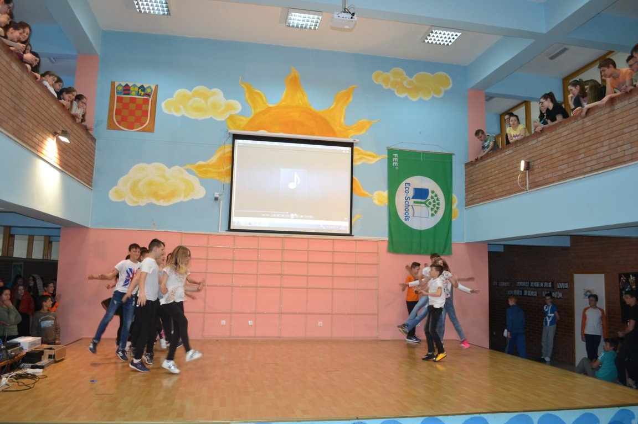
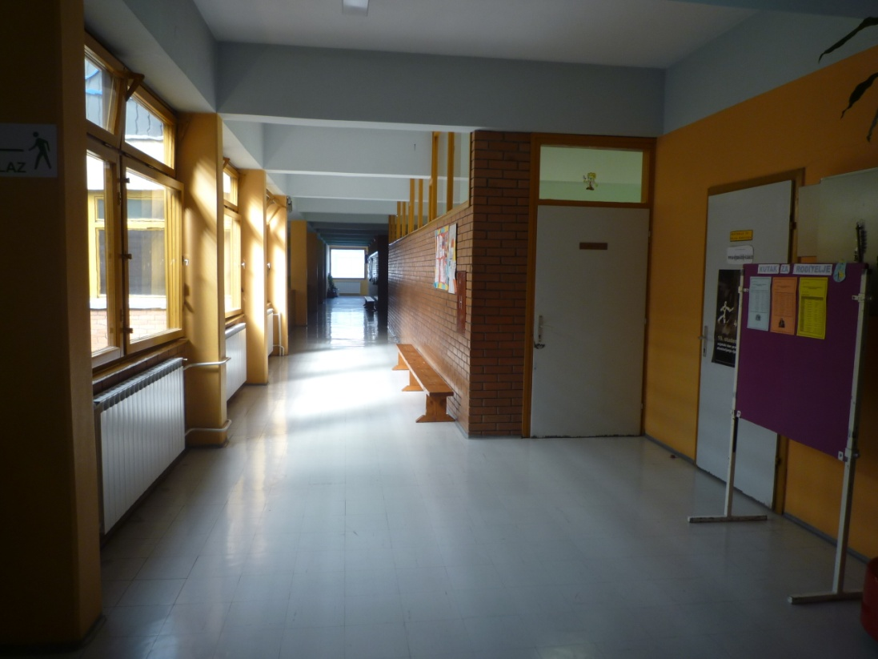
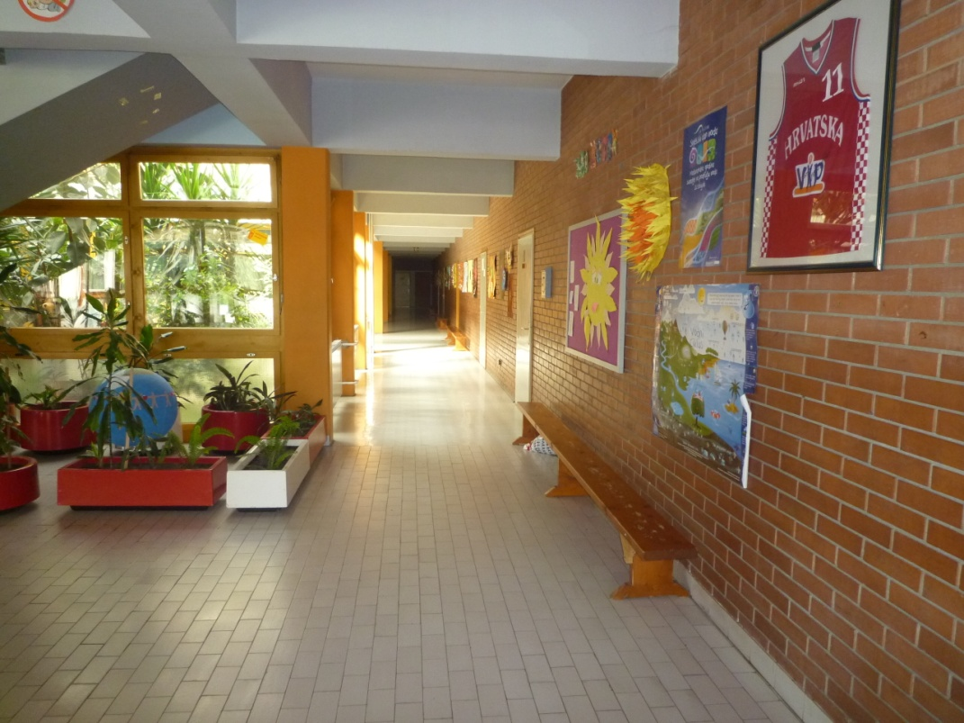
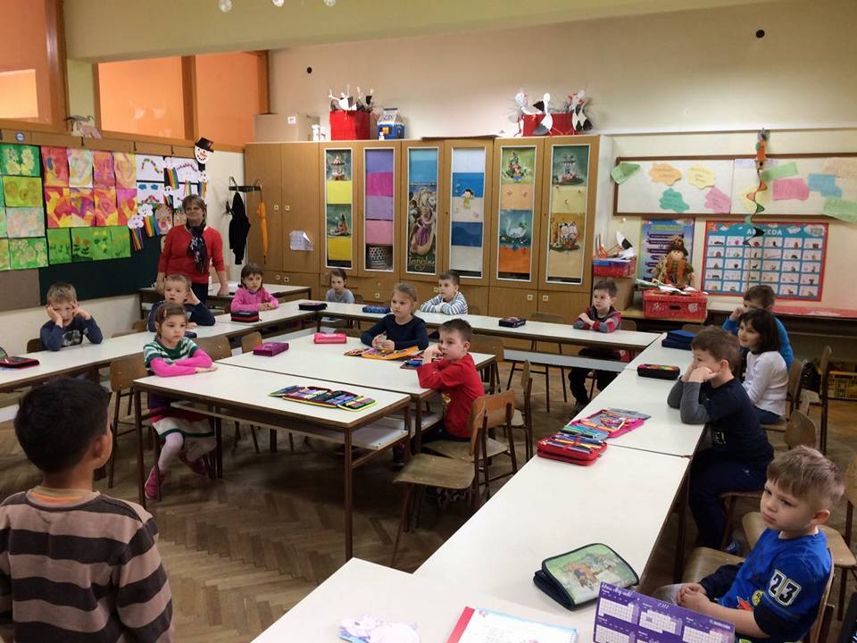
A look at the inside of our school

Slide 5
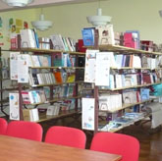
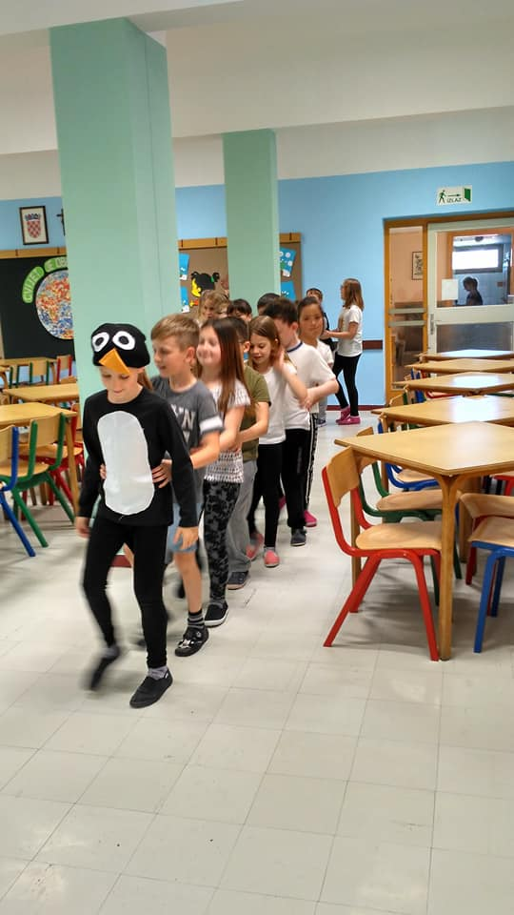
Our school library has around 3500 books and is a place where you can read, watch TV or write homework.
Our school also has three cooks and a canteen where pupils can have lunch during breaks.

Slide 6
Our sports hall

Slide 7
Subjects studied at our school
Croatian
Geography
IT
English Chemistry Technical Education
German Physics
Religion
Art Biology P.E.
Music Science
History Maths

Slide 8
After school activities
Our lessons start at 8 o’clock. Lessons last for 45 minutes. Pupils usually have 6 or 7 lessons a day which last until 1:15 or 2:05. After that pupils can stay at school and take part in extracurricular activities. They work in small groups according to their affinities. Pupils can take part in the following extracurricular groups:
-drama group -eco-group -IT group -dance group
-film group -literature group -arts&crafts group -astronomers
-sports club -robotics -choir -eTwinners

Slide 9
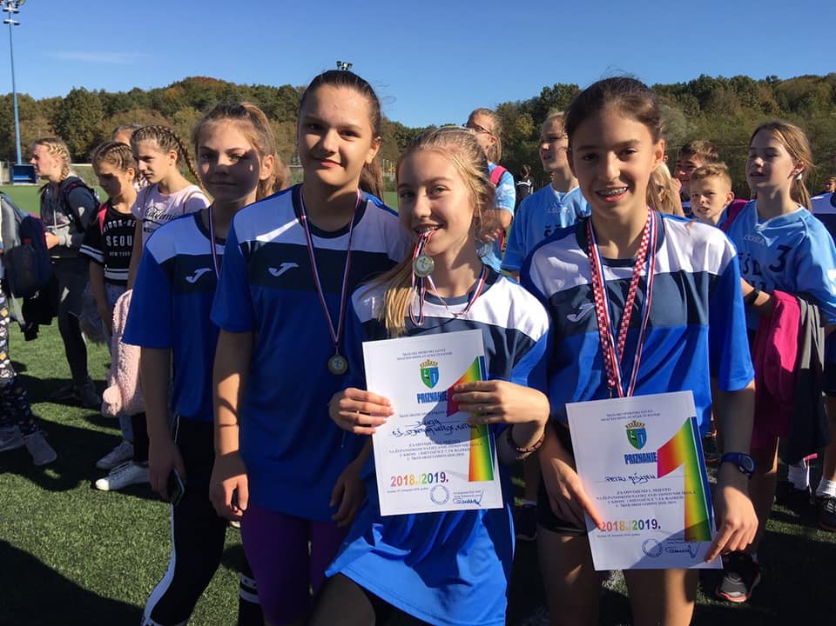
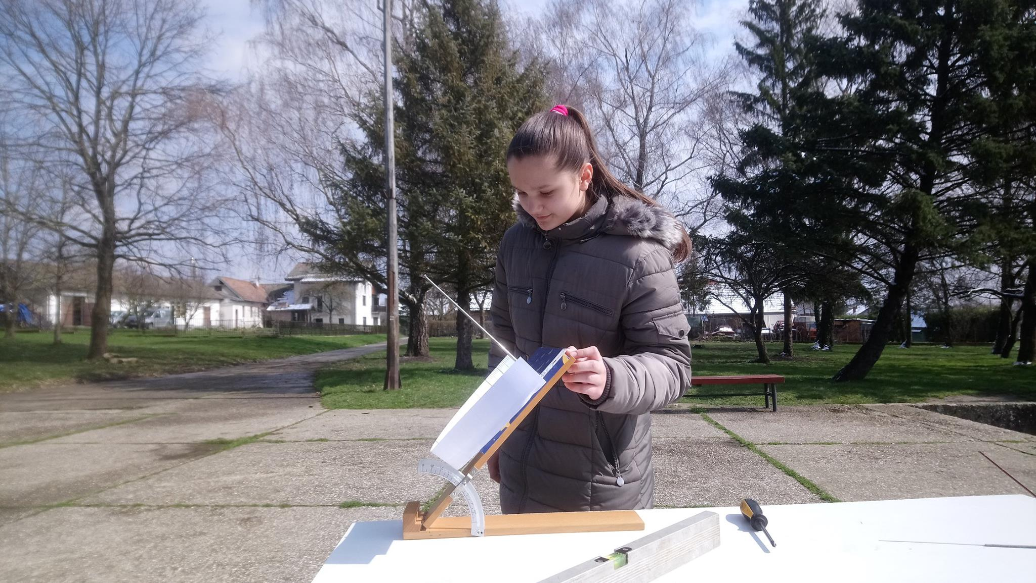
Extracurricular activities in pictures
We win medals in sports competitions, we make films that are shown on children film festivals all over the world, we act out excellent plays and many, many more…We are really proud of what we do after lessons!

